Slide 1
Empowering The Nation
Proudly initiated by precious Radebe
Presented by : AMUKELANI NHLENGETHWA & LWAZI MODISE
THE OFFICIAL WEB AND MOBILE APP DESIGNERS FOR SME- EMPOWERING THE NATION

Slide 2
We developed both a website and a mobile application as part of our project to meet the needs of a small-to-mid-size enterprise (SME) called Empowering the Nation. This SME provides skills training for domestic workers and gardeners, offering both six-month and six-week courses.

Slide 3
Website Creation Process
Web Development: I was responsible for developing the website using HTML, focusing on the design and functionality that would allow users to navigate course offerings, view detailed information on each course, and calculate the total costs with discounts and VAT.
Design Decisions: The website included a user-friendly interface with clear links to the six-month and six-week courses. Each course had a dedicated page with details like content, fees, and purpose. The visual design was guided by the business requirements, ensuring a professional image with a seamless experience for users.
Technology Used: I used HTML to structure the site and ensure it was responsive across devices. The website included interactive features such as a fee calculator, a contact form, and navigation tools, enhancing user engagement.

Slide 4
Mobile Application Development – Lwazi’s Contribution
Mobile App Development: I was responsible for the mobile application, developed using React Native. The app mirrored the website’s functionality, offering users the ability to browse courses, calculate total fees, and access contact information.
App Design: I designed the app with a similar look and feel as the website, ensuring consistency across both platforms. The app was optimized for mobile users, making it easy to navigate and interact with the course content on smartphones.
Technology Used: The mobile app was developed using React Native, a powerful framework for building cross-platform applications. This allowed us to ensure the same features and design elements were available on both web and mobile platforms.

Slide 5
Discount and VAT Calculation
Discount and VAT Calculation: Both the website and mobile app allowed users to select multiple courses, applying discounts based on the number of courses selected (up to 15%) and adding a VAT of 15% to the total. This was done using simple algorithms to ensure accuracy and transparency for users.

Slide 6
Consistency
Consistency Across Platforms: One of the main challenges was ensuring that both the website and mobile app had a similar user experience, especially with respect to design elements like buttons, forms, and navigation. We worked together to align the UI/UX for both platforms.

Slide 7
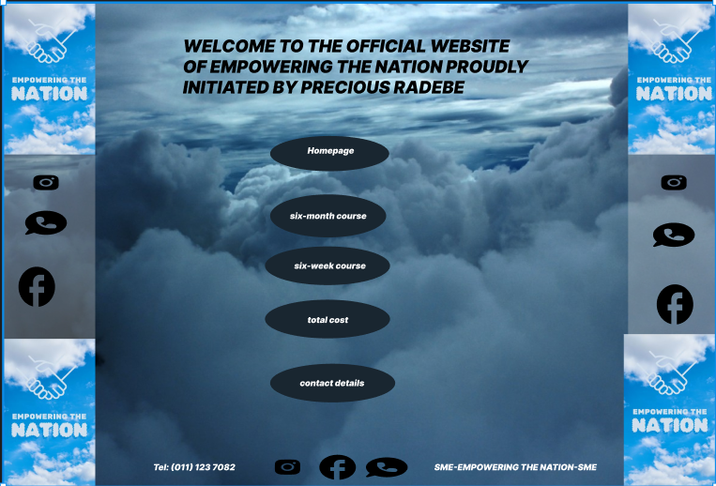
Website desgins

Slide 8
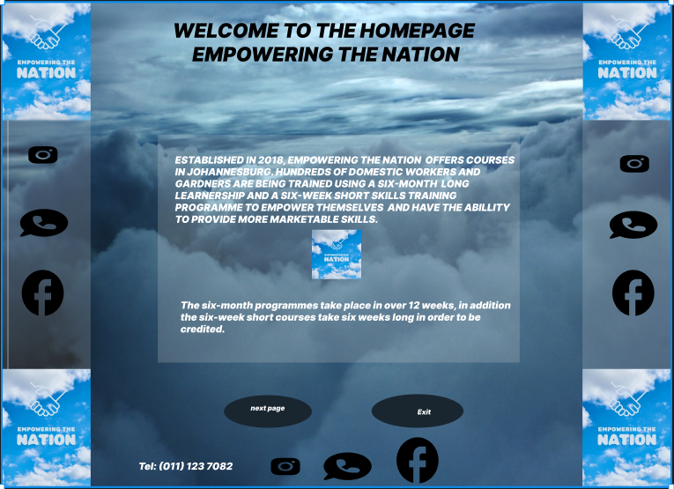

Slide 9
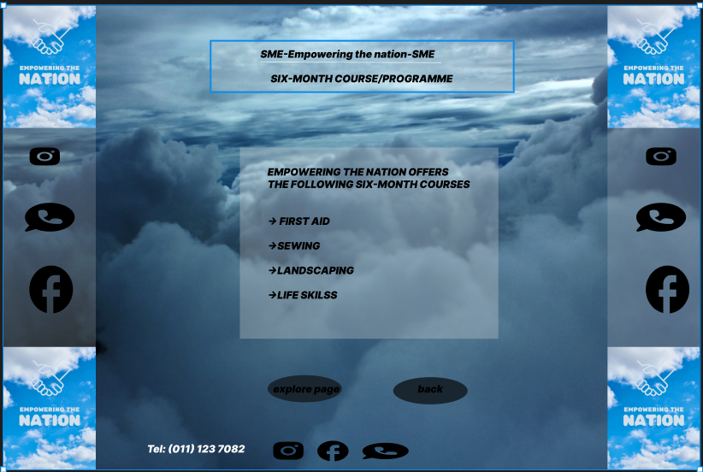
Website designs

Slide 10
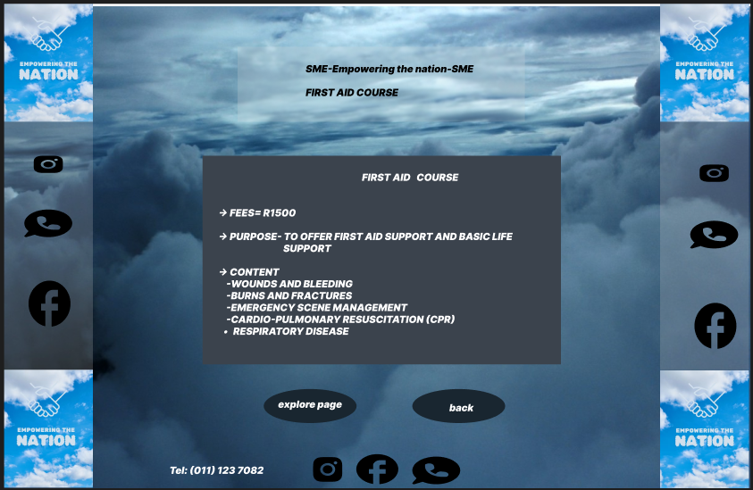
Website designs

Slide 11
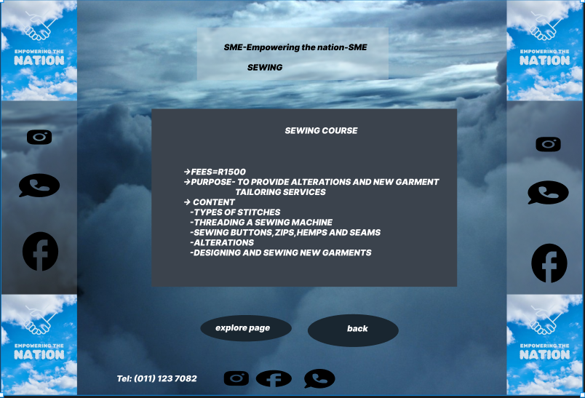
Website designs

Slide 12
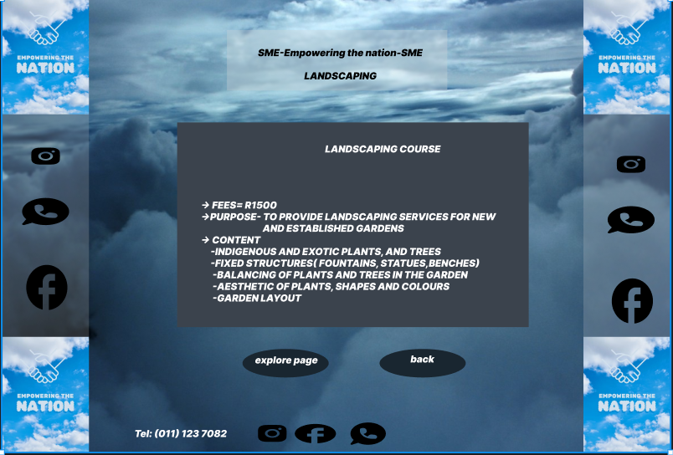
Website designs

Slide 13
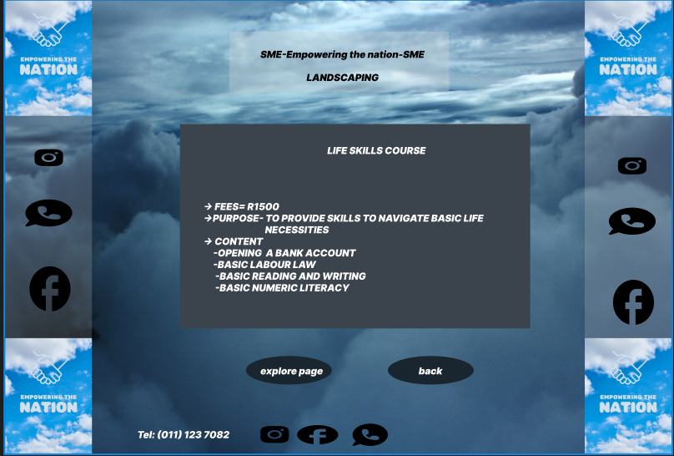
Website designs

Slide 14
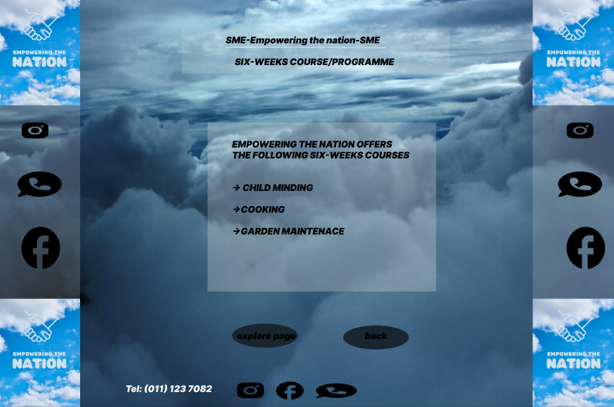
Website designs

Slide 15
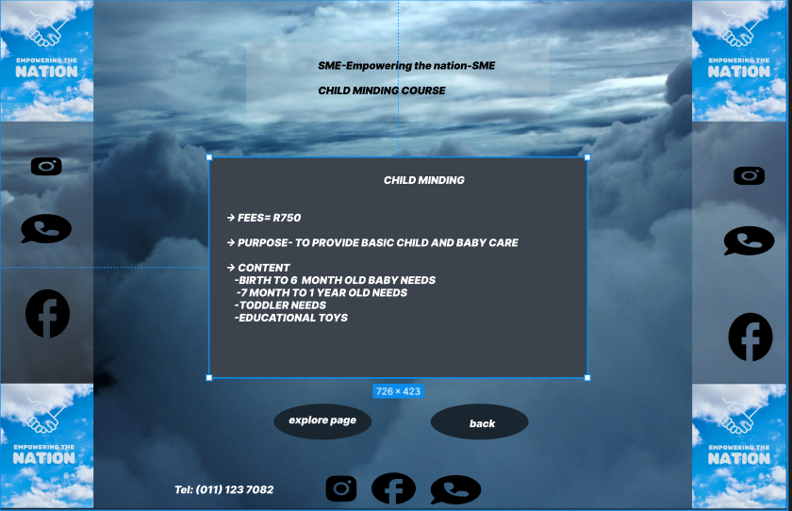
Website designs

Slide 16
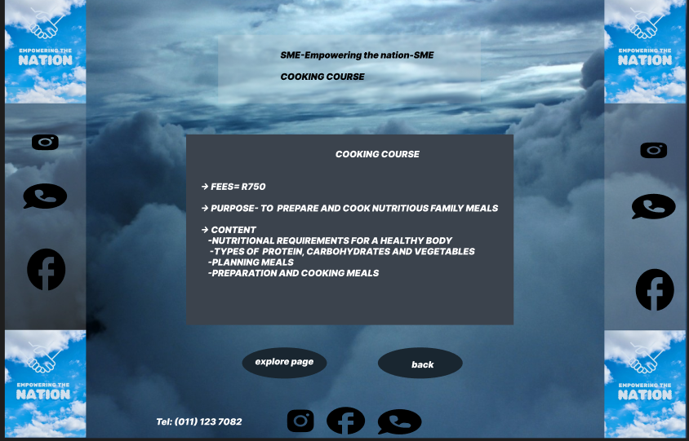
Website designs

Slide 17
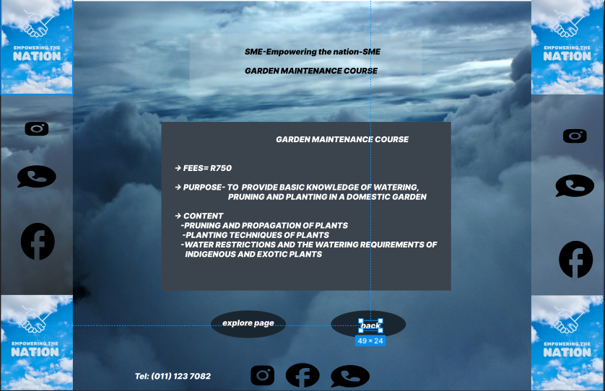
Website designs

Slide 18
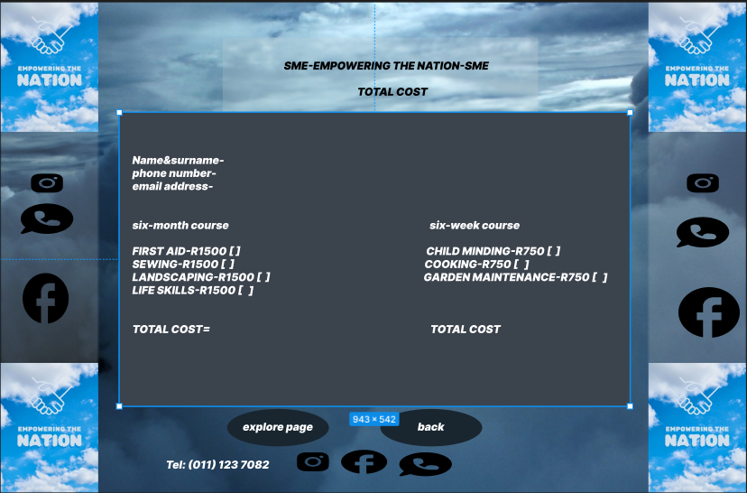
Website designs

Slide 19
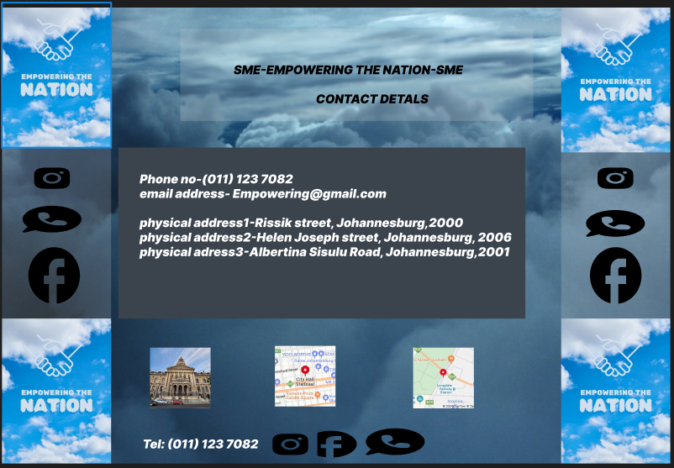
Website designs

Slide 20
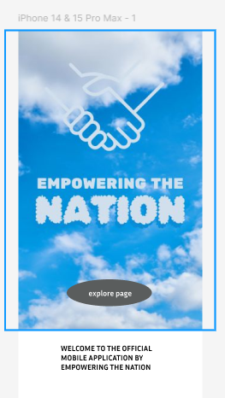
Mobile app designs

Slide 21
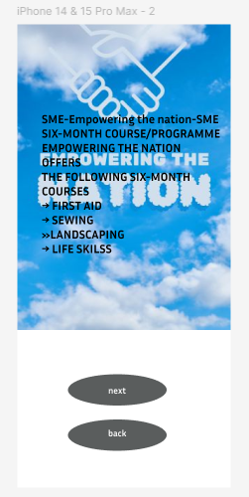
Mobile app designs

Slide 22
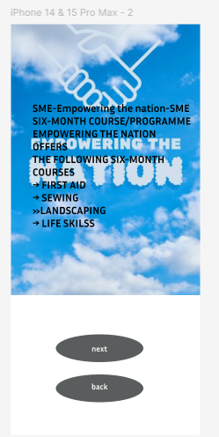
Mobile app designs

Slide 23
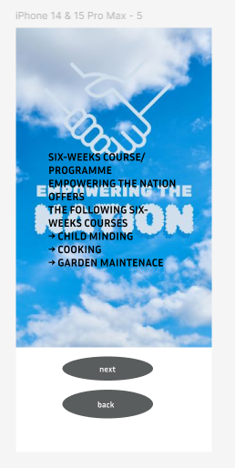
Mobile app designs

Slide 24
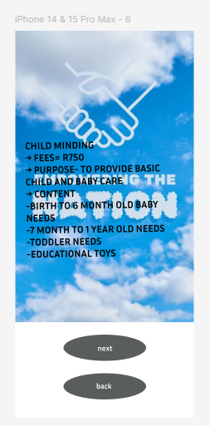
Mobile app designs

Slide 25
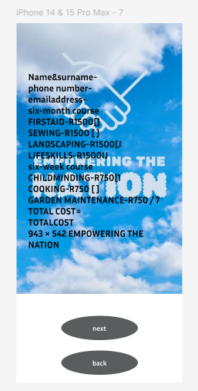
Mobile app designs

Slide 26
Conclusion
Collaboration and Technology: This project allowed us to demonstrate our ability to collaborate effectively and use modern development tools like HTML for web development and React Native for mobile apps. It also highlighted our ability to integrate practical business needs with technical solutions, ensuring that the SME could serve its users effectively through both platforms.

